Slide 1
Cell2Cell Customer Retention

Slide 2


Addressing Customer Churn in Cell2Cell’s Consumer Business
What Factors and Customers Drive Customer Churn?
Customer Needs
High Credit Rating (credita, aa)
Number of three way calls (threeway)
Married (marryyes)
?
Expected Impact on Customer Retention
Current Equipment Age
(Eqpdays)
Has Made Retention Call (retcall)
Overage Minutes Usage (overage)
Number of dropped or blocked calls (dropblk)
Customer Choice

Slide 3
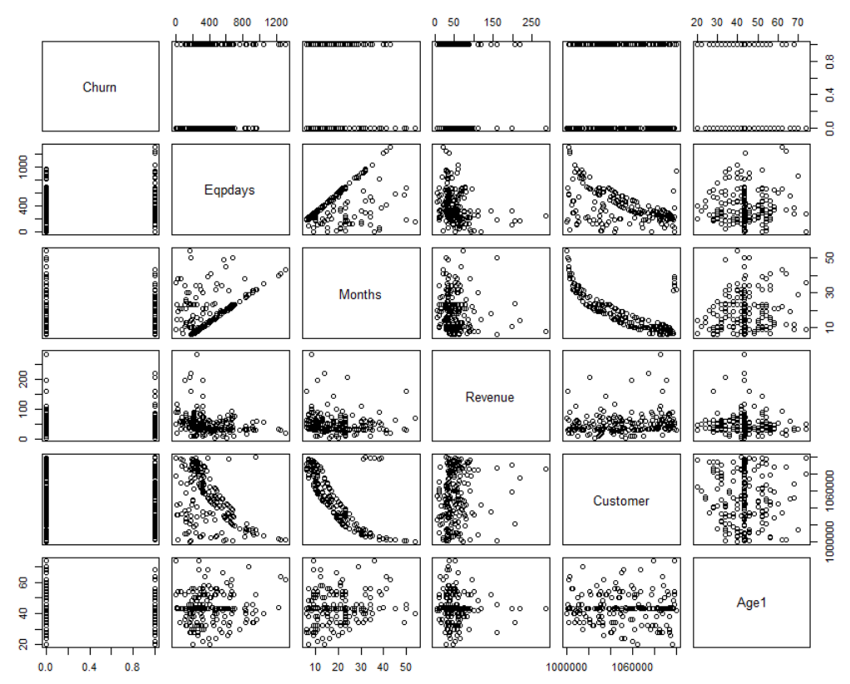
R script outputs
Churn "Has the customer churned
during month (1=Yes, 0=No)"
Eqpdays "Number of days of the
current equipment"
Months "Months in Service"
Recchrge "Mean total recurring charge"
Revenue "Mean monthly revenue"
Csa "Communications Service Area"
Customer "Customer ID"
Age1 "Age of first HH member"
Age2 "Age of second HH member"
Mailflag "Has chosen not to be solicited
by mail"
Retcall "Customer has made call to
retention team"

Slide 4
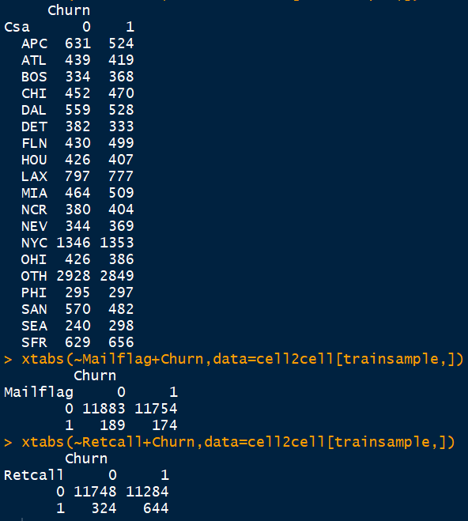
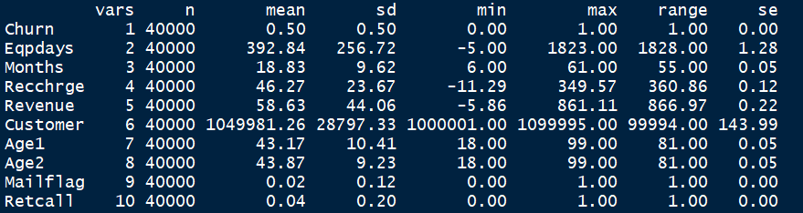
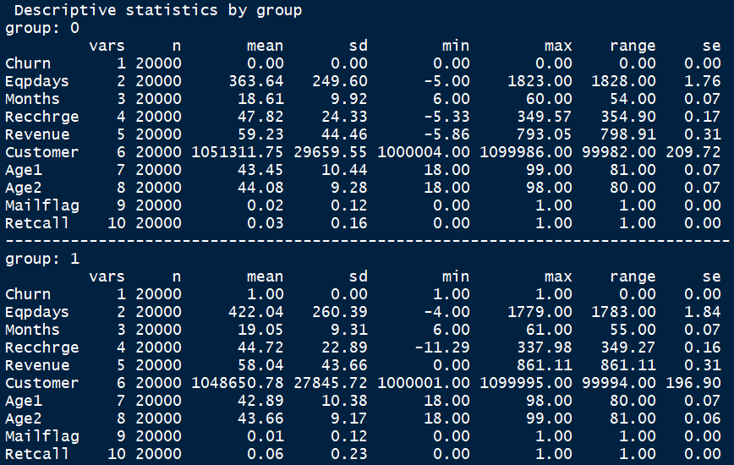
R script outputs

Slide 5
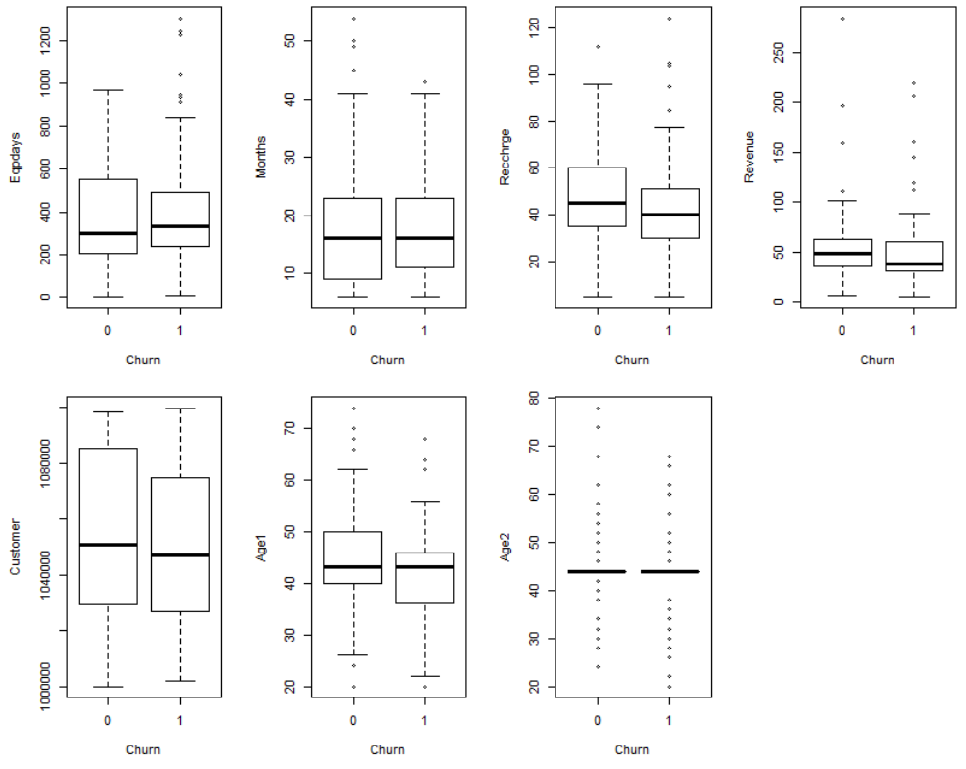
R script outputs

Slide 6
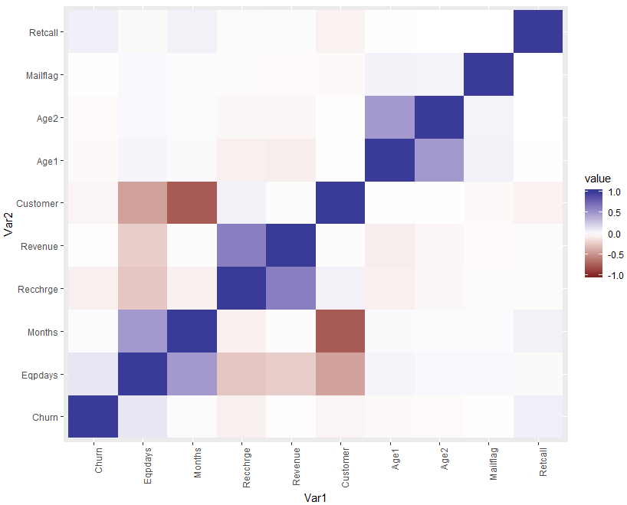
R script outputs

Slide 7
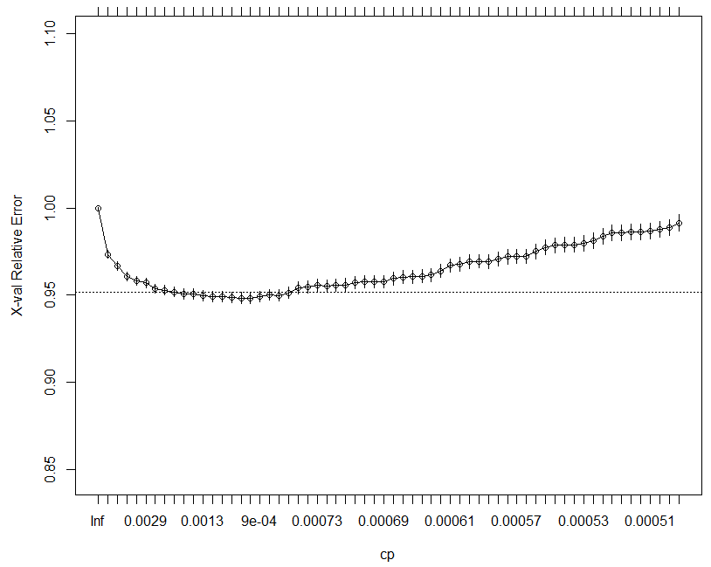
R script outputs – Tree cp vs error

